Slide 1

JAVA PROJECT
Notes:
We designed this template so that each member of the project team has a set of slides with its own theme. Members, here’s how you add a new slide to just your set:
Mark where you want to add the slide: Select an existing one in the Thumbnails pane, click the New Slide button, then choose a layout. The new slide gets the same theme as the other slides in your set.
Careful! Don’t annoy your fellow presenters by accidentally changing their themes. That can happen if you choose a different theme from the Design tab, which changes all of the slides in the presentation to that look.

Slide 2

JAVA PROJECT
Session : Spring 21-22
Section : F
Course Name : Object Oriented Programming1[JAVA]
Instructor : Tasnim Pervin
Project Title : Online Quiz
Group Name : Sinister Trio
Group Members:
NAME | ID
Sakib Hossain | 21-45388-3
Badhon Nath Joy | 21-45390-3
Tanjib Ul Islam | 21-45393-3

Slide 3
What is gui?
GUI stands for Graphical User Interface.
GUI is used not only in Java but also in all programming languages that support the development of GUIs.
A program's graphical user interface presents an easy-to-use visual display to the user.

Slide 4
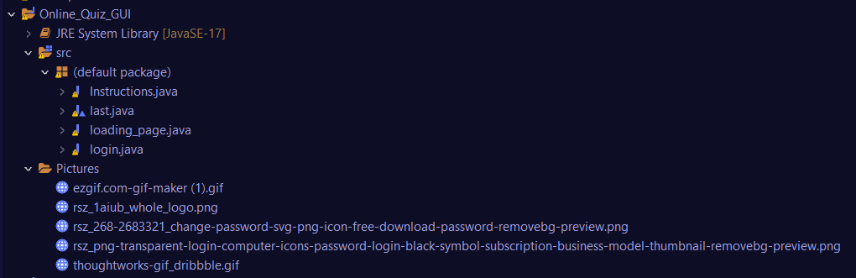
Total 4 JFrame

Slide 5
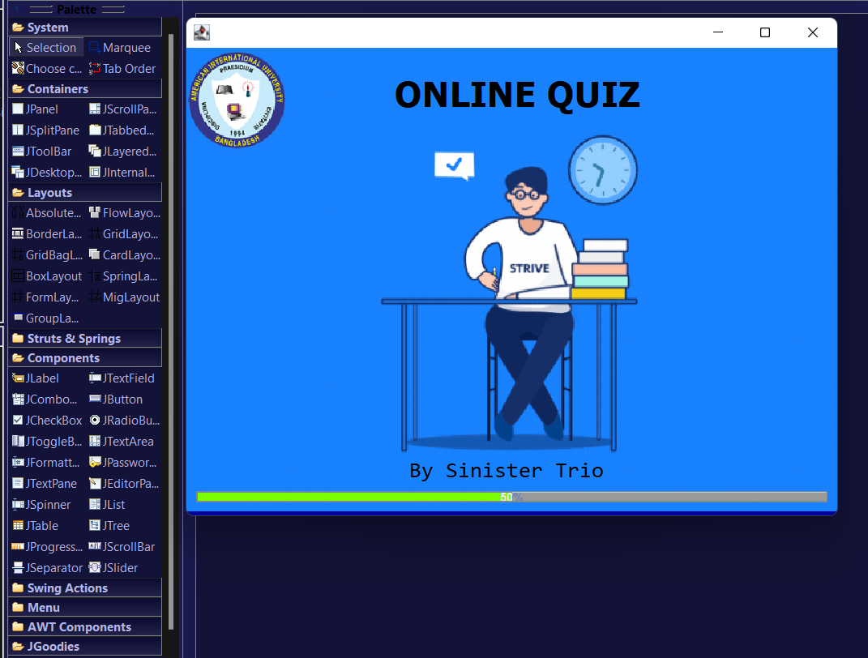
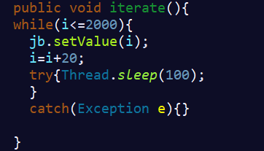
Frame
gif
JLabel
JProgressBar

Slide 6
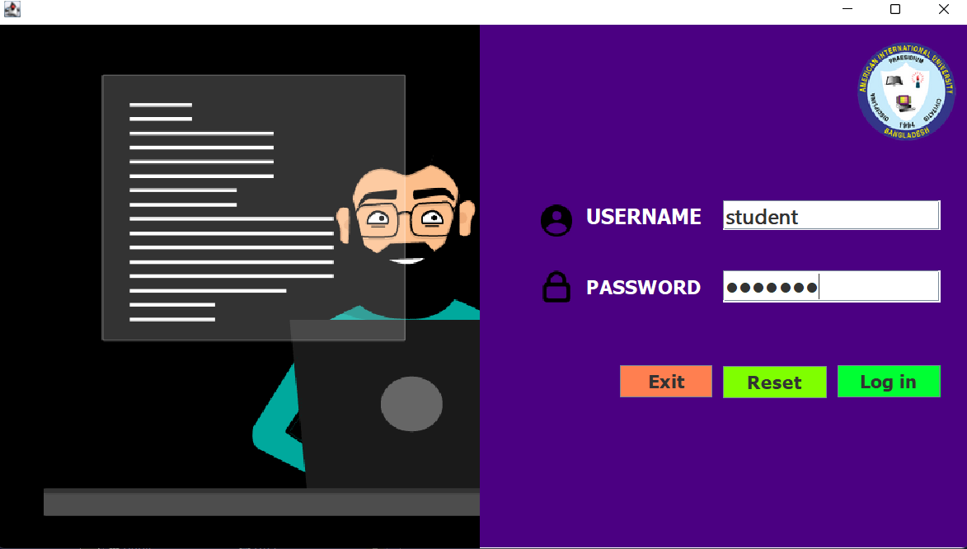
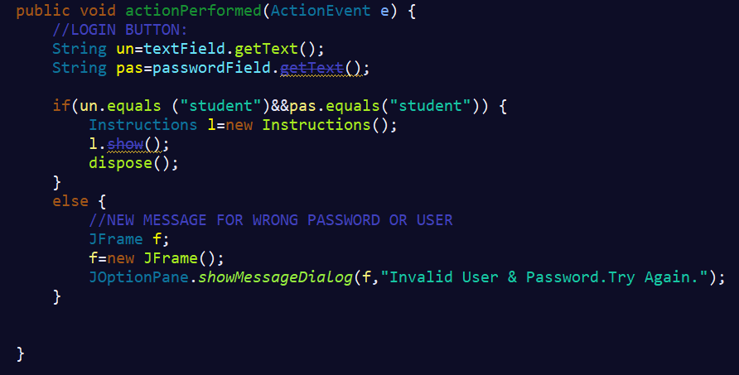
LOGIN PAGE
JTextField
JPasswordField
JButton
Exit Button: System.exit(0);
Reset Button: textField.setText(null);
passwordField.setText(null);
Log In Button:

Slide 7
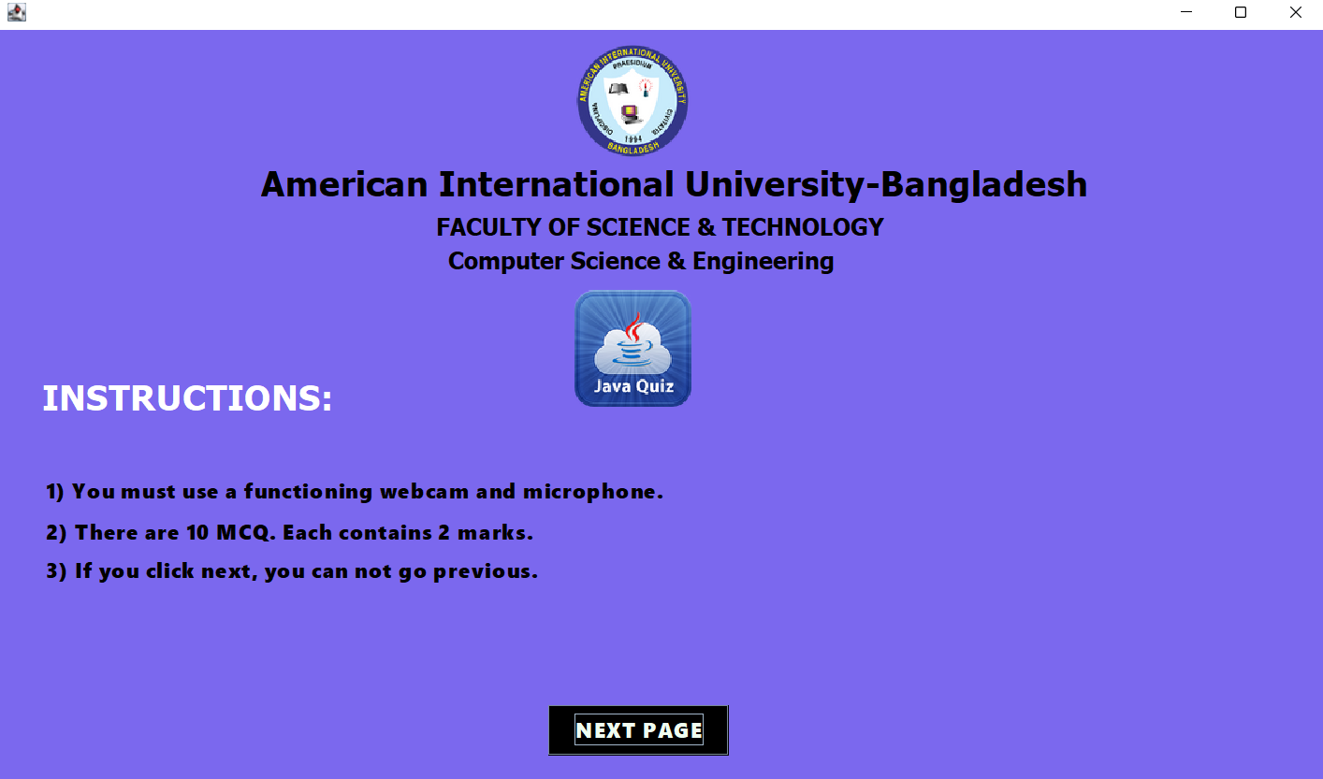
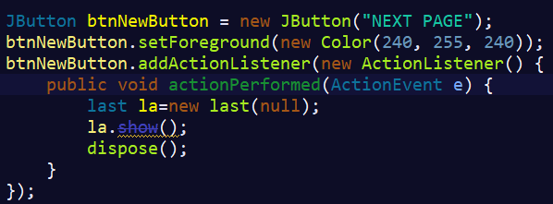
Instructions Page
JButton

Slide 8
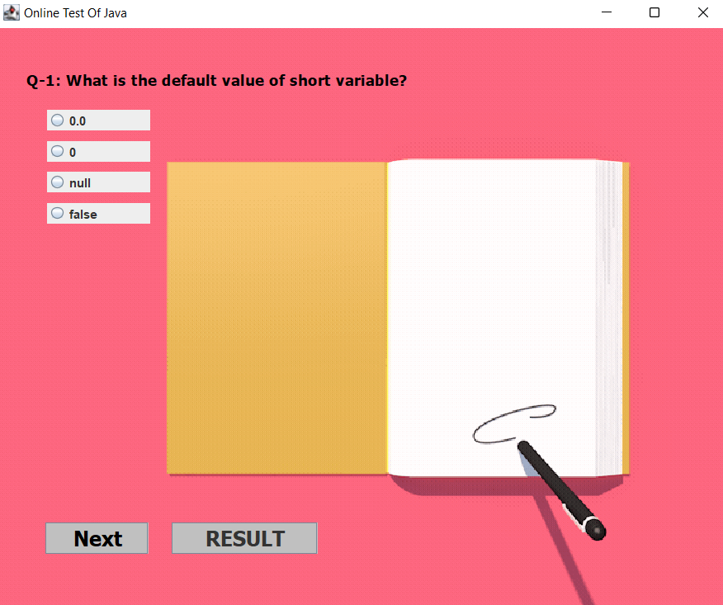
QUIZ PAGE
JRadioButton
JButton

Slide 9
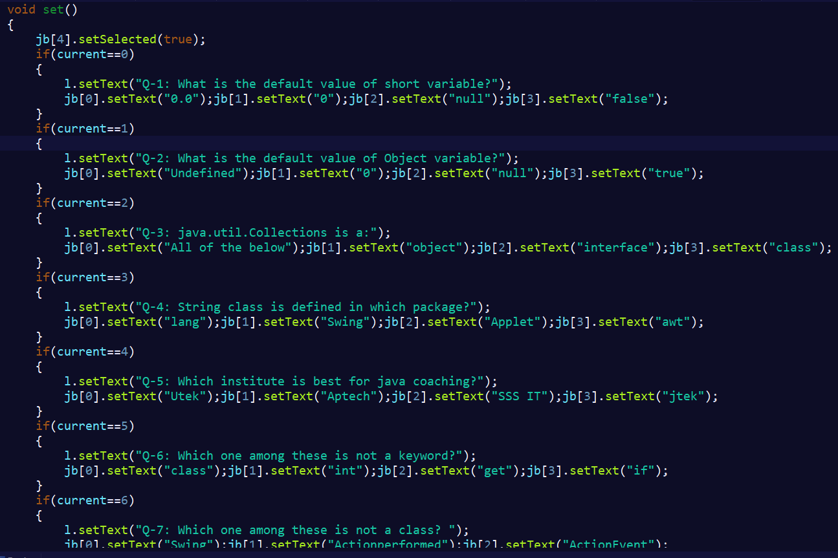
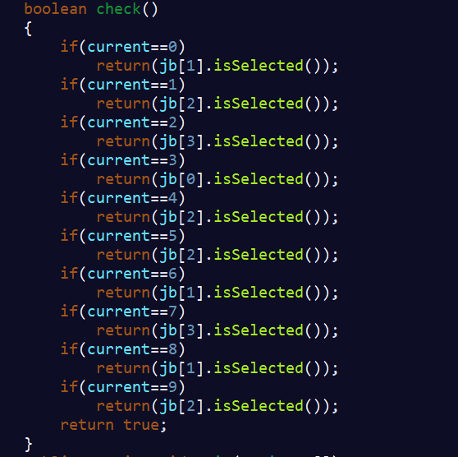
QUIZ’S QUESTIONS:
QUIZ’S ANSWERS:

Slide 10
THANK YOU

